Slide 1

Estimating parameter for Covid-19: A Mathematical Approach
MENTOR:
DR. DEBASMITA MUKHERJEE
MEMBERS:
VIDIT PARESH SHETH, A004
JINAV DHIREN GALA, A007
YASH RAJESH SHAH, A013

Slide 2
Covid-19 Outbreak
December 2019, occurred in Wuhan City, China
Affected people of all ages, including children, adults, and elderly individuals
Triggered considerable fear and anxiety among the public, especially when the death toll rapidly climbed
Extensive standardized educational health campaigns and assessment of prior knowledge are necessary for preventing disease outbreaks by improving public awareness

Slide 3
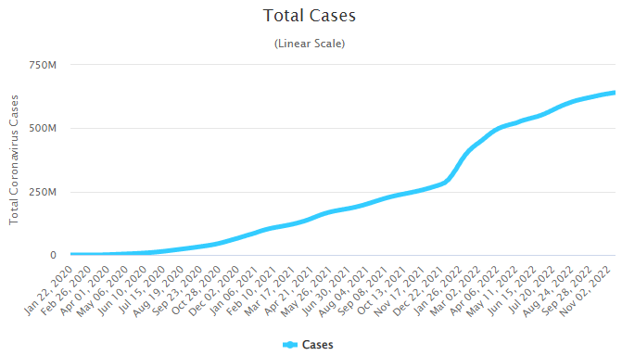
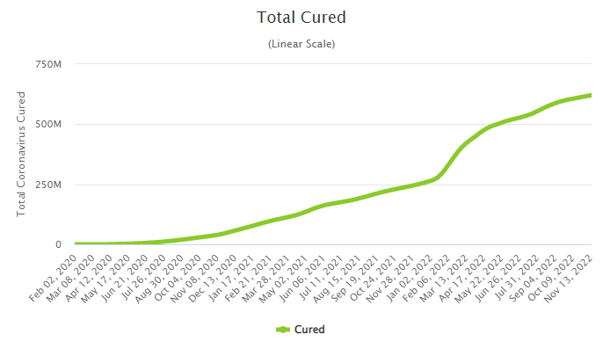
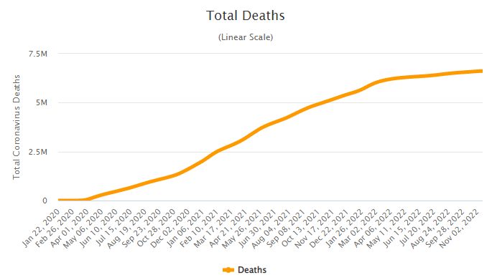
Covid-19 statistics
Case Distribution | Number
Total Cases | 640,649,137
Total Cured | 620,409,556
Total Deaths | 6,616,556
Source: worldometer

Slide 4
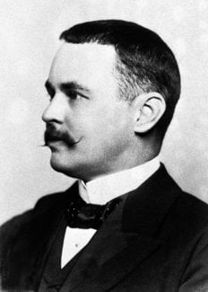
SIR Model
Developed by Ronald Ross, William Hamer, and others in the early twentieth century
Consists of a system of three coupled non-linear ordinary differential equations
Simple tools from calculus extract information about the solutions

Slide 5
SIR Model
Some factors make it difficult to deal with such a highly infectious and deadly disease, especially in high population density countries such as India
Developed to provide insights and make predictions about the pandemic, to plan effective control strategies and policies
Helpful to understand and predict the possibility and severity of the disease outbreak and, provide key information to determine the intensity of COVID-19 disease intervention

Slide 6
SIR Model
Susceptible
Infected
Recovered

Slide 7
Susceptible
Encounter with an infectious individual and can contract the disease (with some probability)

Slide 8
Infected
Capable of infecting susceptible individuals

Slide 9
Recovered
Have been infected and are now removed (immune or deceased)

Slide 10
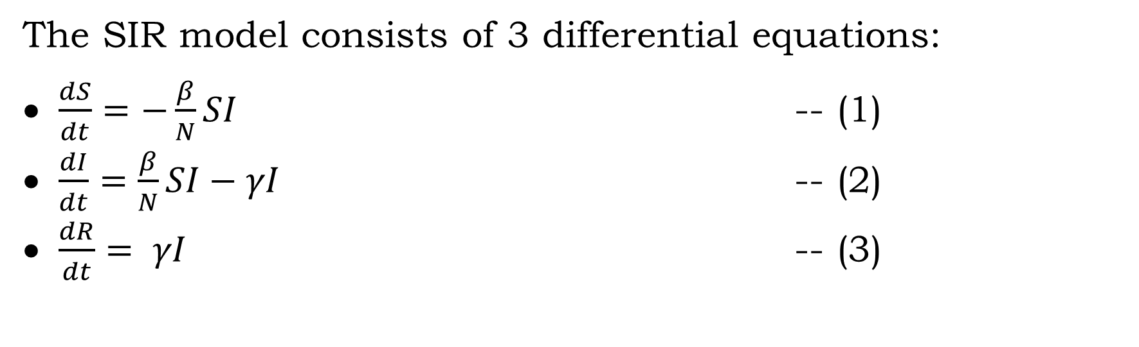
Model walkthrough
The SIR model consists of 3 differential equations:
$\frac{dS}{dt}=−\frac{β}{N}SI$ -- (1)
$\frac{dI}{dt}=\frac{β}{N}SI−γI$ -- (2)
$\frac{dR}{dt}= γI$ -- (3)

Slide 11
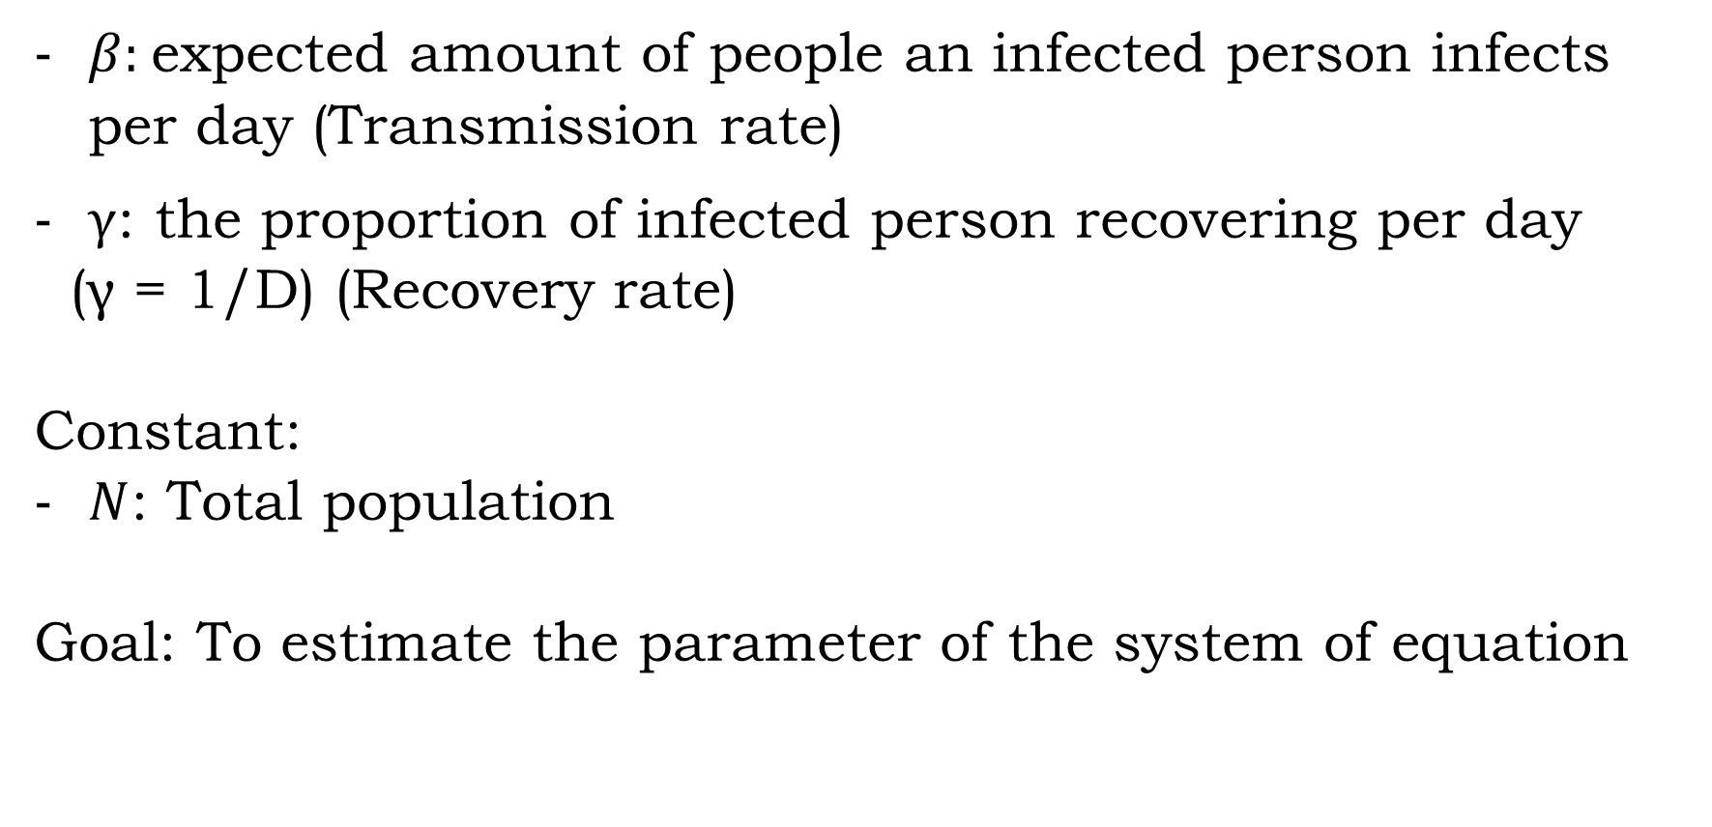
Parameters
$β:$expected amount of people an infected person infects per day (Transmission rate)
$γ$: the proportion of infected person recovering per day
(γ = 1/D) (Recovery rate)
Constant:
$N$: Total population
Goal: To estimate the parameter of the system of equation

Slide 12
Assumptions of SIR Model
No one joins the susceptible group, since we are ignoring births and immigration and we are assuming that people can be infected only once
The probability to contract the disease for all individuals in the population is the same
Homogenous mixing of the population

Slide 13
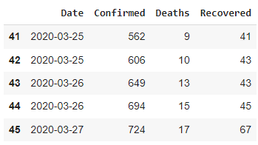
About the Dataset

Slide 14
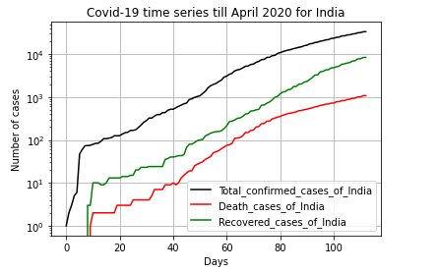
Covid-19 statistics for India

Slide 15
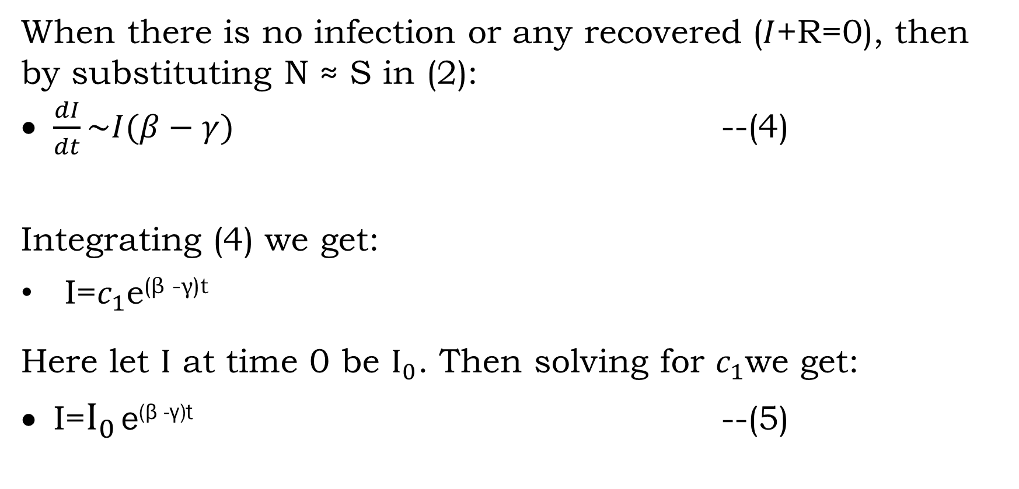
When there is no infection or any recovered ($I$+R=0), then by substituting N ≈ S in (2):
$\frac{dI}{dt}\sim I(β−γ)$ --(4)
Integrating (4) we get:
I=$c_{1}$e^{(β -γ)t}
Here let $I$ at time 0 be $I_{0}$. Then solving for $c_{1}$we get:
I=$I_{0}$ e^{(β -γ)t} --(5)

Slide 16
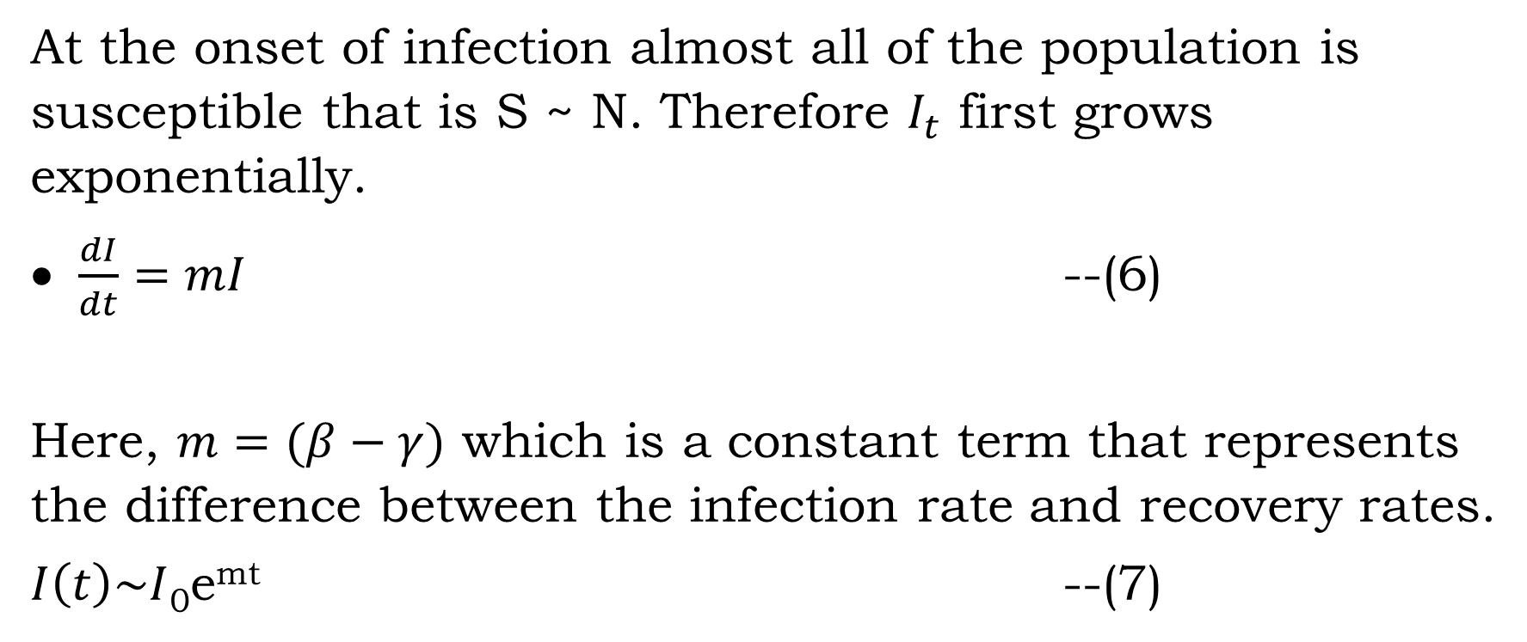
At the onset of infection almost all of the population is susceptible that is S ~ N. Therefore $I_{t}$ first grows exponentially.
$\frac{dI}{dt}=mI$ --(6)
Here, $m=(β−γ)$ which is a constant term that represents the difference between the infection rate and recovery rates.
$I\left(t\right)\sim I$₀e^{mt} --(7)

Slide 17
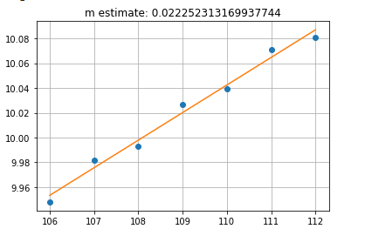
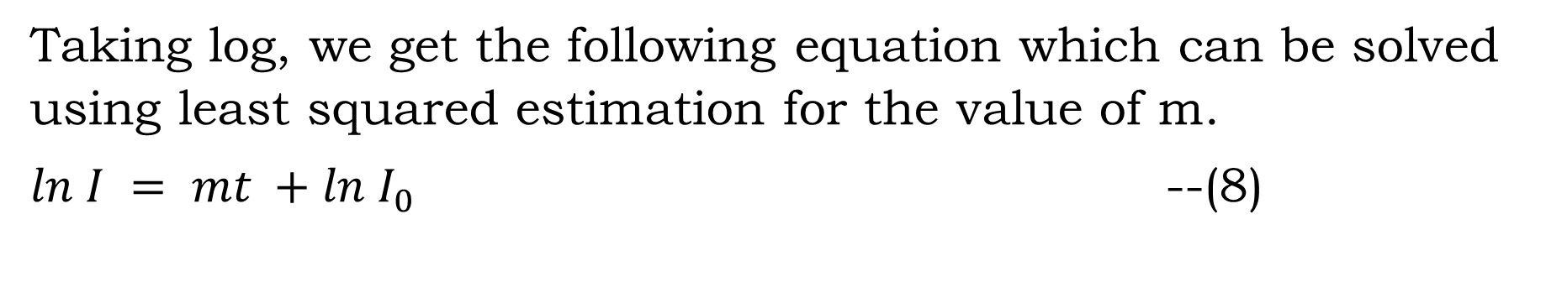
Taking log, we get the following equation which can be solved using least squared estimation for the value of m.
$ln I = mt +ln I_{0}$ --(8)

Slide 18
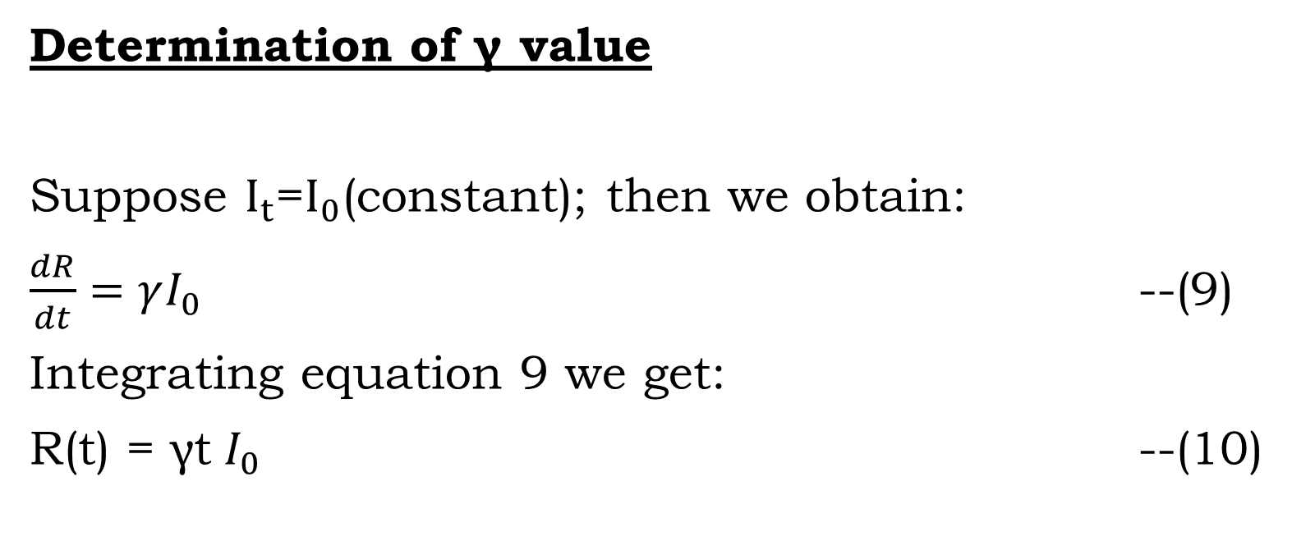
Determination of γ value
Suppose $I_{t}$=$I_{0}$(constant); then we obtain:
$\frac{dR}{dt}=γI_{0}$ --(9)
Integrating equation 9 we get:
R(t) = γt $I_{0}$ --(10)

Slide 19
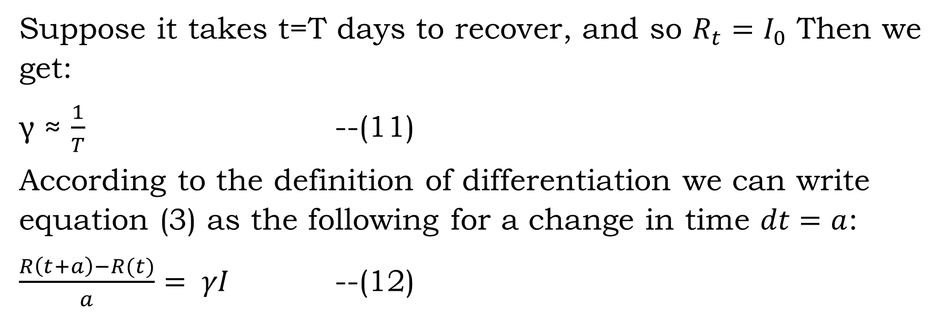
Suppose it takes t=T days to recover, and so $R_{t}=I_{0}$ Then we get:
γ ≈ $\frac{1}{T}$ --(11)
According to the definition of differentiation we can write equation (3) as the following for a change in time $dt=a$:
$\frac{R\left(t+a\right)−R(t)}{a}= γI$ --(12)

Slide 20

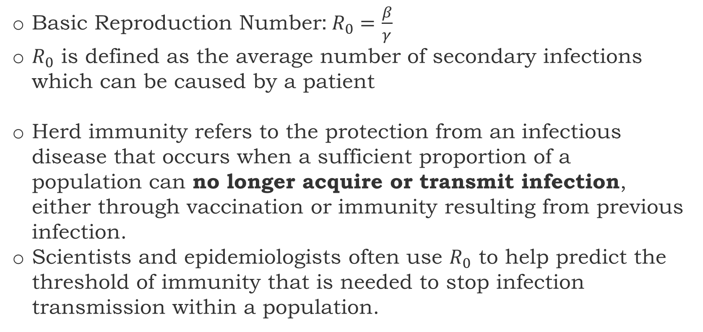
About $R_{0}$ and Herd Immunity
Basic Reproduction Number:$R_{0}=\frac{β}{γ}$
$R_{0}$ is defined as the average number of secondary infections which can be caused by a patient
Herd immunity refers to the protection from an infectious disease that occurs when a sufficient proportion of a population can no longer acquire or transmit infection, either through vaccination or immunity resulting from previous infection.
Scientists and epidemiologists often use $R_{0}$ to help predict the threshold of immunity that is needed to stop infection transmission within a population.

Slide 21
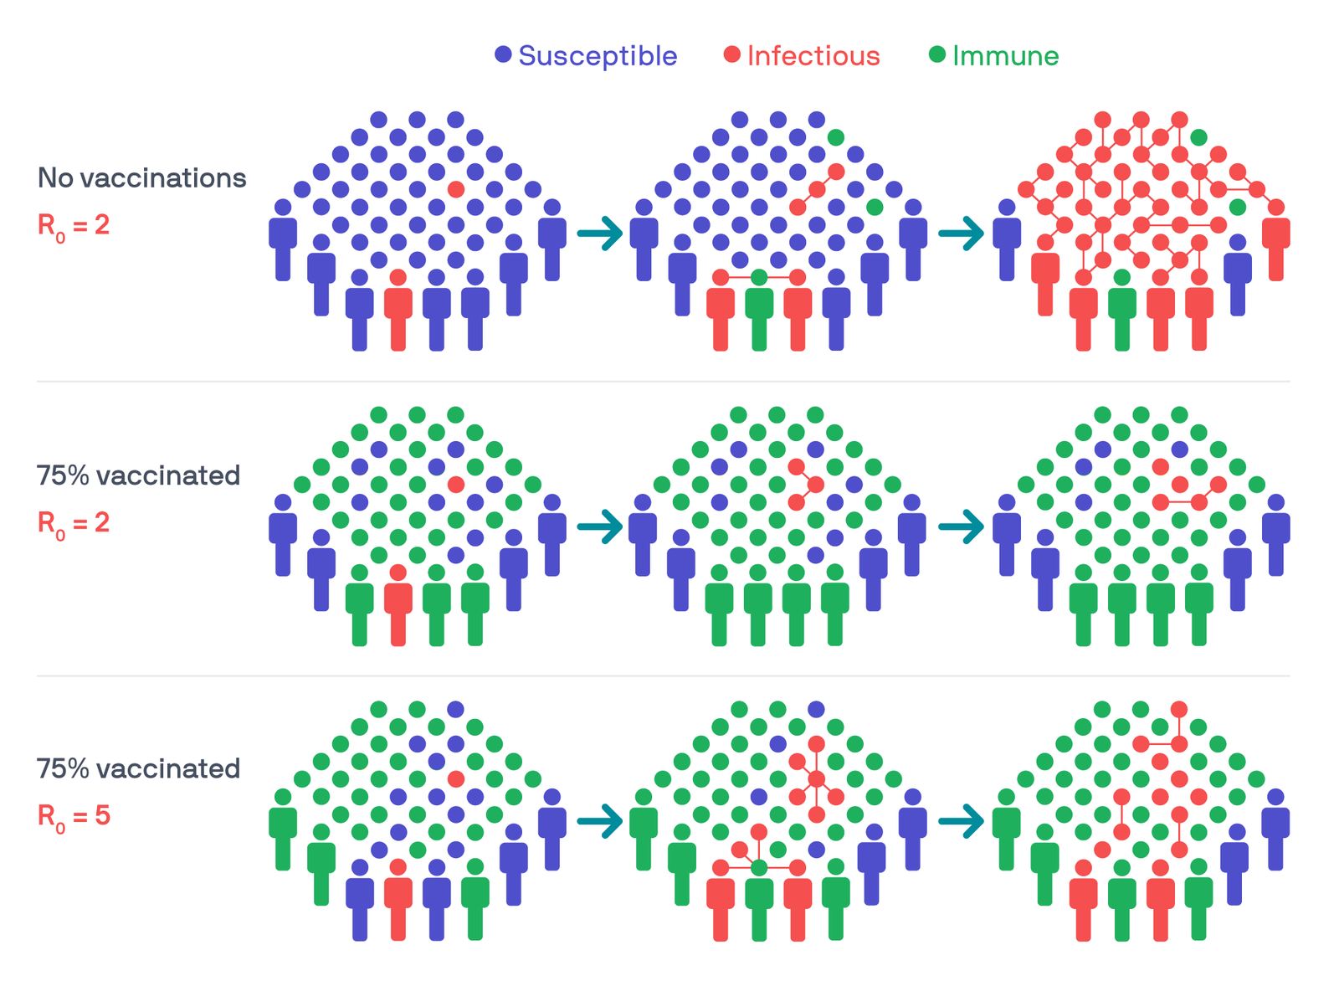

Slide 22
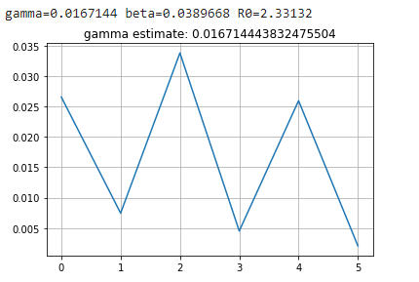

Slide 23
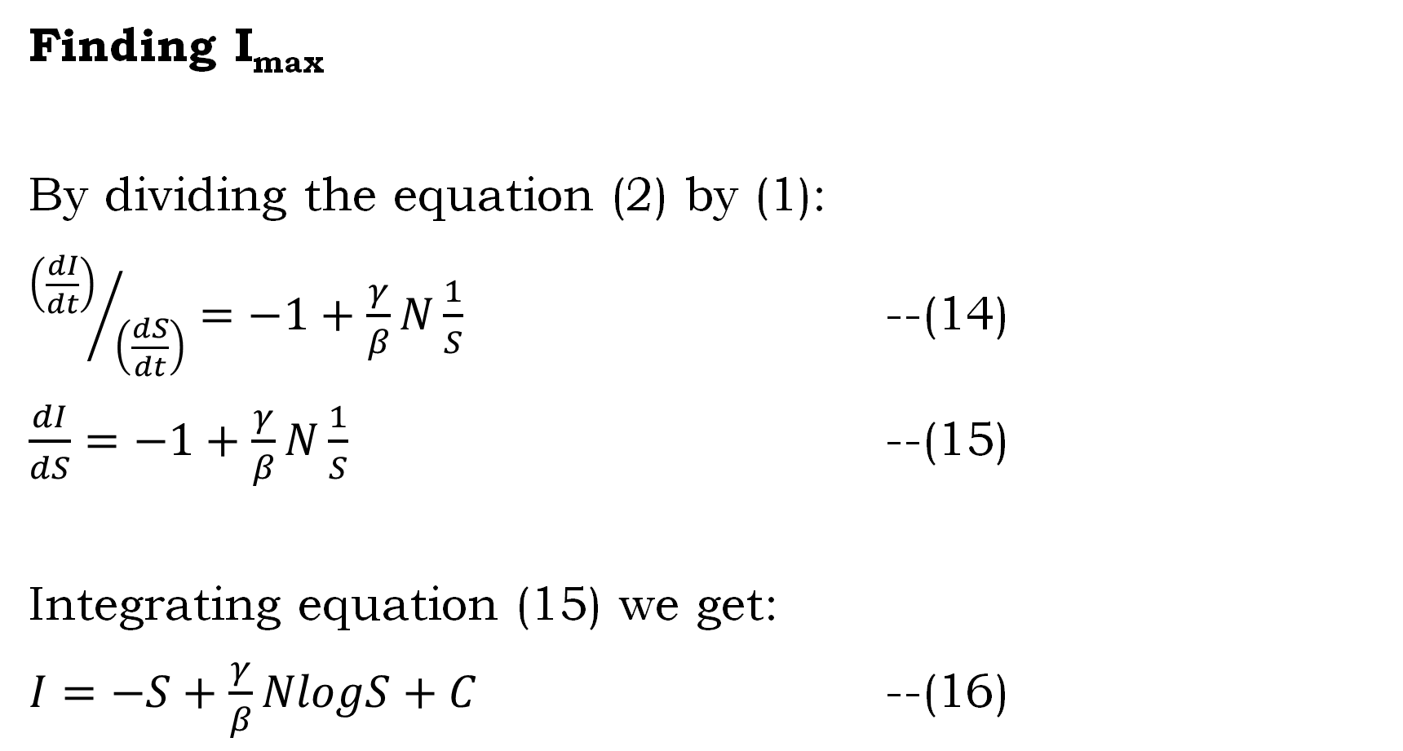
Finding I_{max}
By dividing the equation (2) by (1):
${\left(\frac{dI}{dt}\right)}/{\left(\frac{dS}{dt}\right)}=−1+\frac{γ}{β}N\frac{1}{S}$ --(14)
$\frac{dI}{dS}=−1+\frac{γ}{β}N\frac{1}{S}$ --(15)
Integrating equation (15) we get:
$I=−S+\frac{γ}{β}NlogS+C$ --(16)

Slide 24
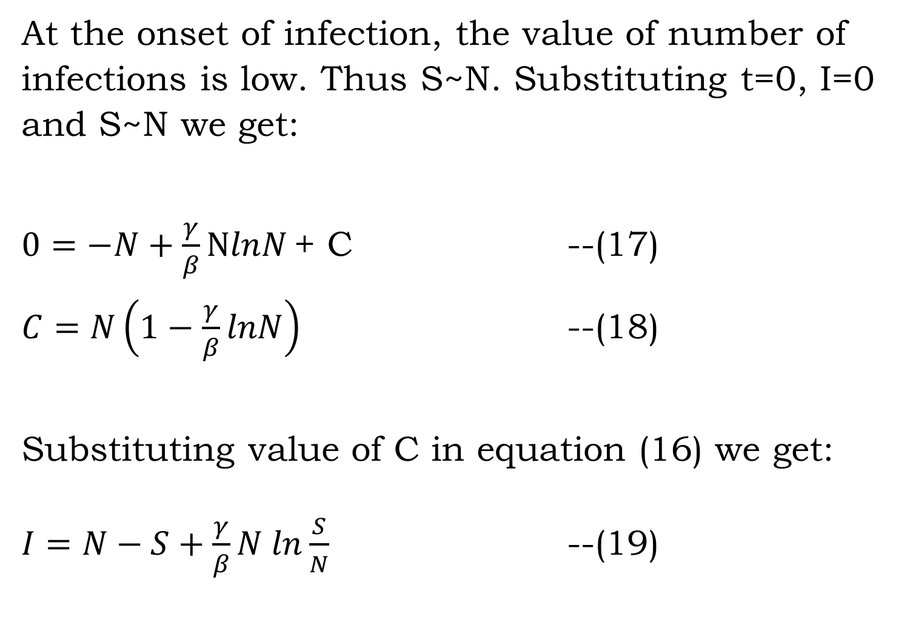
At the onset of infection, the value of number of infections is low. Thus S~N. Substituting t=0, I=0 and S~N we get:
$0=−N+\frac{γ}{β}NlnN$ + C --(17)
$C=N\left(1−\frac{γ}{β}lnN\right)$ --(18)
Substituting value of C in equation (16) we get:
$I=N−S+\frac{γ}{β}N ln\frac{S}{N}$ --(19)

Slide 25
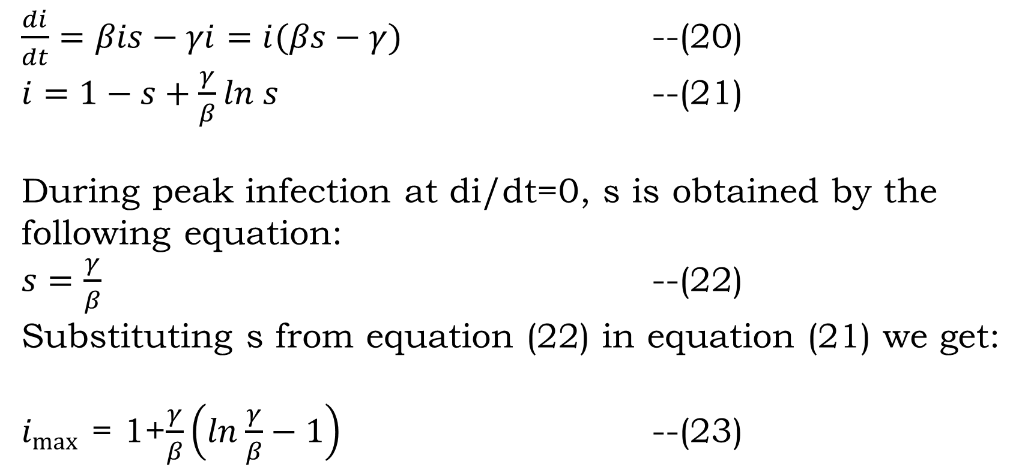
$\frac{di}{dt}=βis−γi=i(βs−γ)$ --(20)
$i=1−s+\frac{γ}{β}ln s$ --(21)
During peak infection at di/dt=0, s is obtained by the following equation:
$s=\frac{γ}{β}$ --(22)
Substituting s from equation (22) in equation (21) we get:
$i_{max}$ = 1+$\frac{γ}{β}\left(ln\frac{γ}{β}−1\right)$ --(23)

Slide 26
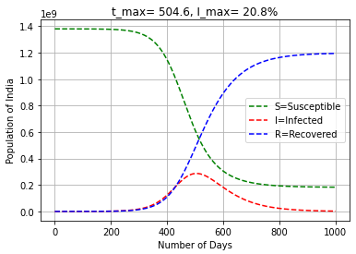

Slide 27
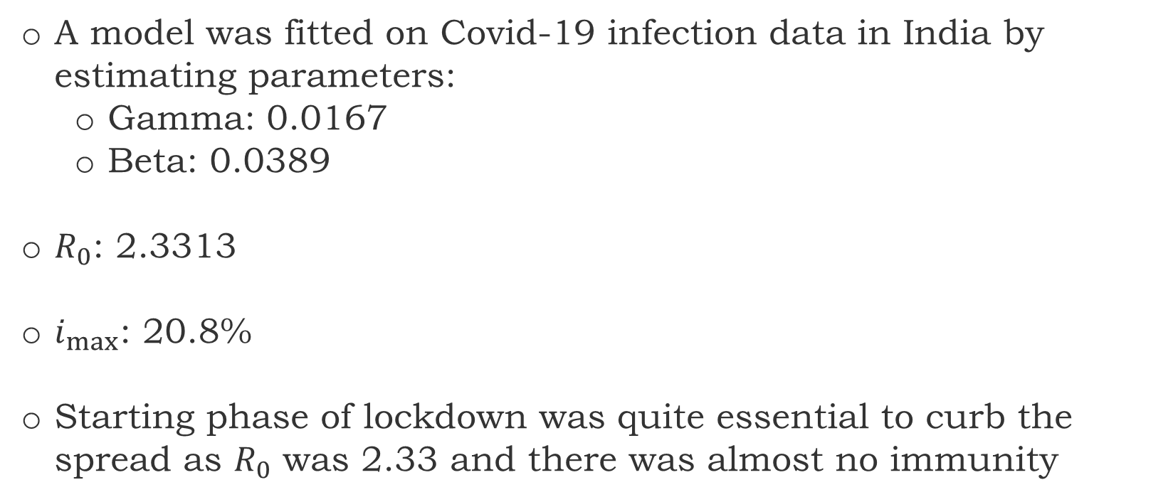
Conclusion
A model was fitted on Covid-19 infection data in India by estimating parameters:
Gamma: 0.0167
Beta: 0.0389
$R_{0}$: 2.3313
$i_{max}$: 20.8%
Starting phase of lockdown was quite essential to curb the spread as $R_{0}$ was 2.33 and there was almost no immunity

Slide 28
Future Scope
Include an exposed period where an individual has no clinical signs of the disease but is infectious (SEIR)
There are other models whereupon recovery, there is no immunity (SIS model) or where immunity lasts only for a short period (SIRS).
Include reduction strategies, such as quarantine and vaccinations.
Work extension with monkeypox and different viruses

Slide 29
Your patience is appreciated!
Thank You

